Slide 1
Lecture 04: Correlation
Chris Walshaw
Computing & Mathematical Sciences
University of Greenwich

Slide 2
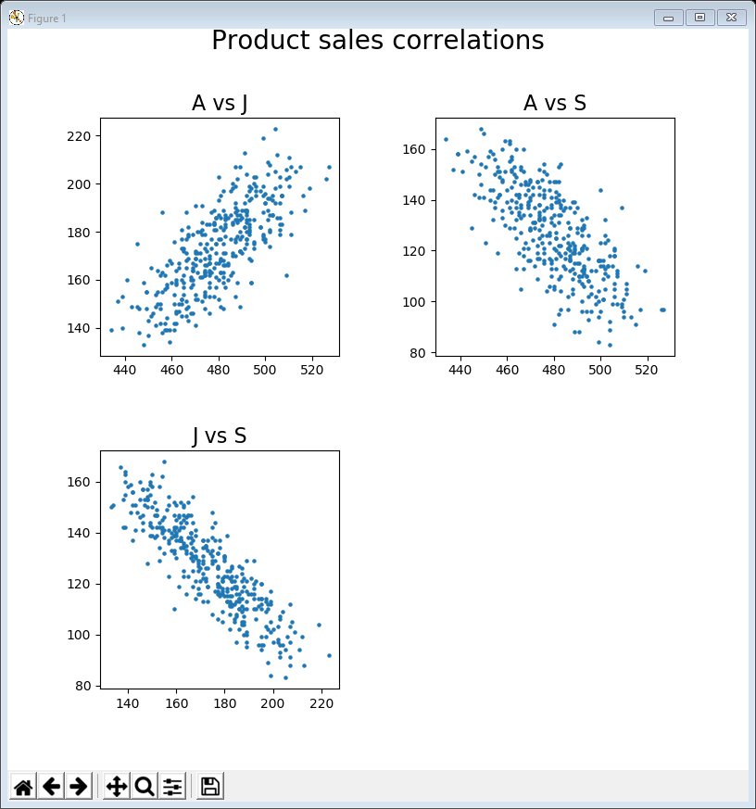
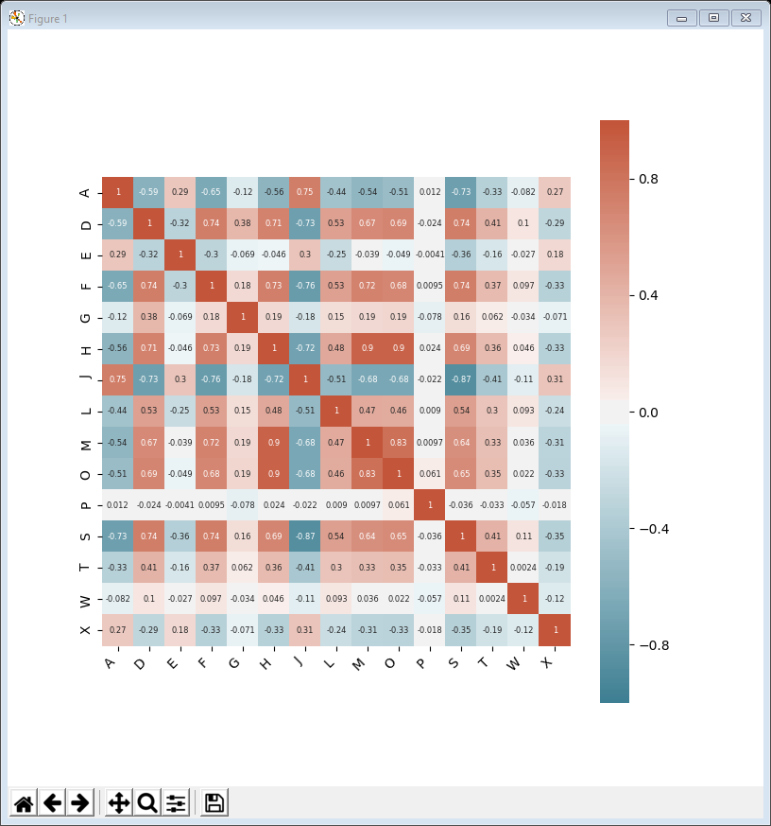
Motivation / Objectives
The company who supplied the data want to know about products that
don’t sell well or
aren’t very profitable or
cost too much to market or …
Last week we looked at time-series and trends
averages, rolling averages, trendlines, …
Today we take a closer look at how some of those trends may be related to each other using two further standard visualisations
scatter plots
heat maps

Slide 3
Common features
Most of today’s examples contain the same lines of code at the top
import the libraries & read in the data
And as before the following lines prepare and show the plot
However we shall also meet another library, called Seaborn, for the heatmap examples
import matplotlib.pyplot as plt
import pandas as pd
data = pd.read_csv('https://tinyurl.com/ChrisCoDV/Products/DailySales.csv’,
index_col=0)
pd.plotting.register_matplotlib_converters()
data.index = pd.to_datetime(data.index)
plt.figure(figsize=(8, 8))
... # this is where you draw the plot
plt.show()

Slide 4
Correlation?
Correlation refers to a mutual relationship between two or more things
or formally in statistics it refers to the interdependence of variables
For example, we can expect a positive correlation between temperature and ice cream sales
when it’s hot, people buy more ice cream
Or we can expect an inverse (or negative) correlation between temperature and sales of gloves
when it’s hot, people buy fewer gloves
However, there is a famous saying, that “correlation is not causation”
meaning that just because two things are related does not mean one causes the other
For example, as ice cream sales increase, so do cases of sunburn
ice cream sales and sunburn are probably correlated
but eating ice cream does not cause sunburn
There are a whole list of examples at
https://en.wikipedia.org/wiki/Correlation_does_not_imply_causation

Slide 5
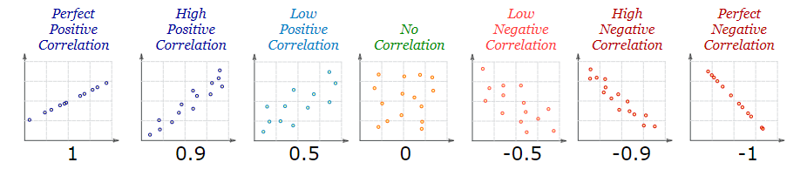
Scatter plots
The usual way to visualise correlation is with a scatter plot
take any two variables, e.g. A & B, with common index values (e.g. dates)
for each index value (e.g. each date), plot A’s value along the x-axis against B’s value on the y-axis with a small dot at the location (A, B)
If you get
a diagonal line sloping upwards, left to right, the variables are positively correlated
a diagonal line sloping downwards, left to right, the variables are negatively (inversely) correlated
randomly scattered dots, the variables are not correlated
Source: https://www.mathsisfun.com/data/correlation.html

Slide 6
Picking pairs
To look at correlations in high volume products, A, F & L, we want scatter plots of every pair (3 plots in total)
A vs F, A vs L
F vs L
For medium volume, G, H, J, S, W, we need10 plots
G vs H, G vs J, G vs S, G vs W
H vs J, H vs S, H vs W
J vs S, J vs W
S vs W
The way to achieve this is with a nested pair of loops
if selected contains a list of products, then each iteration name_i will contain one product name and name_j another
if there are n items in selected, it produces ½ n(n-1) plots
for i, name_i in enumerate(selected):
for j in range(i + 1, len(selected)):
name_j = selected[j]

Slide 7
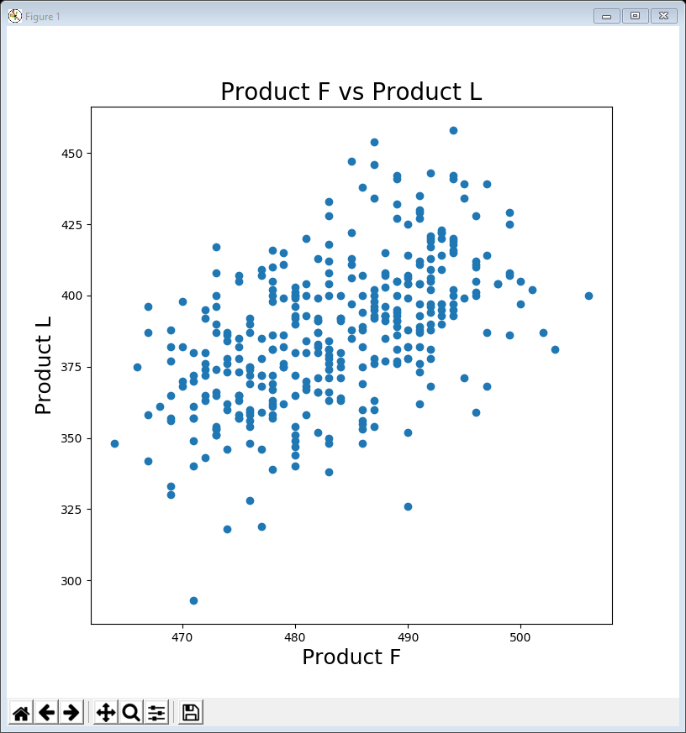
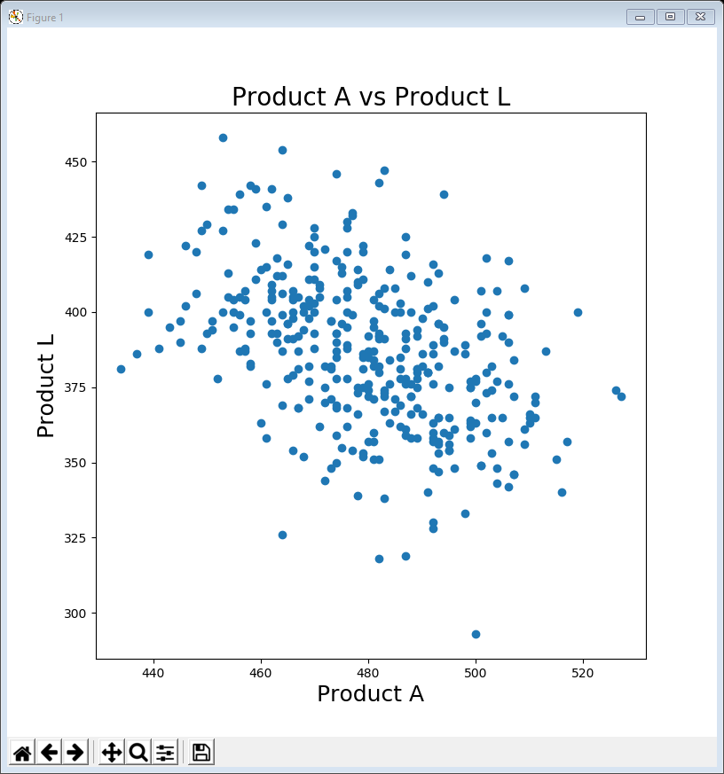
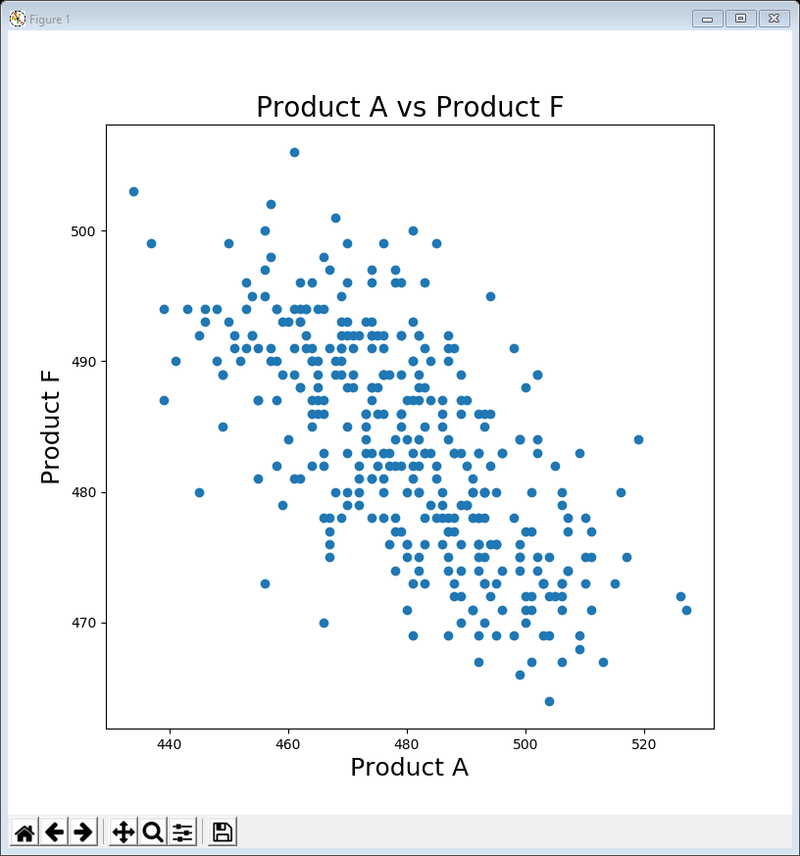
01ScatterPlot high volume.py
The following code creates the 3 plots on the right
The single line in bold actually creates the scatter plot
As before, the other lines prepare each figure, add labels and title and finally show it
selected = ['A', 'F', 'L']
for i, name_i in enumerate(selected):
for j in range(i + 1, len(selected)):
name_j = selected[j]
plt.figure(figsize=(8, 8))
plt.scatter(data[name_i], data[name_j])
plt.title('Product ' + name_i
+ ' vs Product ' + name_j, fontsize=20)
plt.xlabel('Product ' + name_i, fontsize=18)
plt.ylabel('Product ' + name_j, fontsize=18)
plt.show()

Slide 8
Subplots & faceting
Visualising correlations like this involves a lot of scatter plots
for the 3 high volume products we need 3 plots
for the 5 medium volume products we need 10
for the 7 low volume products we would need 21!
Rather than creating a separate plot each time, we can produce a single figure with lots of subplots
useful in lots of situations, not just correlations
This is also known as faceting
each subplot shows a different facet of the visualisation

Slide 9
Subplot code
Typical code for creating subplots looks like this
create the figure and add a title
add another subplot and give it a title – in this example we are adding to a 4 x 4 square of subplots (so a maximum of 16)
adjust spacing between subplots (doesn’t always work perfectly so you may need to modify wspace and hspace)
counter = 1
fig = plt.figure(figsize=(8, 8))
fig.suptitle('FIGURE TITLE', fontsize=14, position=(0.5, 1.0))
for i, name_i in enumerate(selected):
for j in range(i + 1, len(selected)):
name_j = selected[j]
sub = fig.add_subplot(4, 4, counter)
sub.set_title('Subplot Title', fontsize=10)
... # draw the subplot here
counter += 1
plt.subplots_adjust(wspace=1.0, hspace=1.0)
plt.tight_layout()
plt.show()

Slide 10
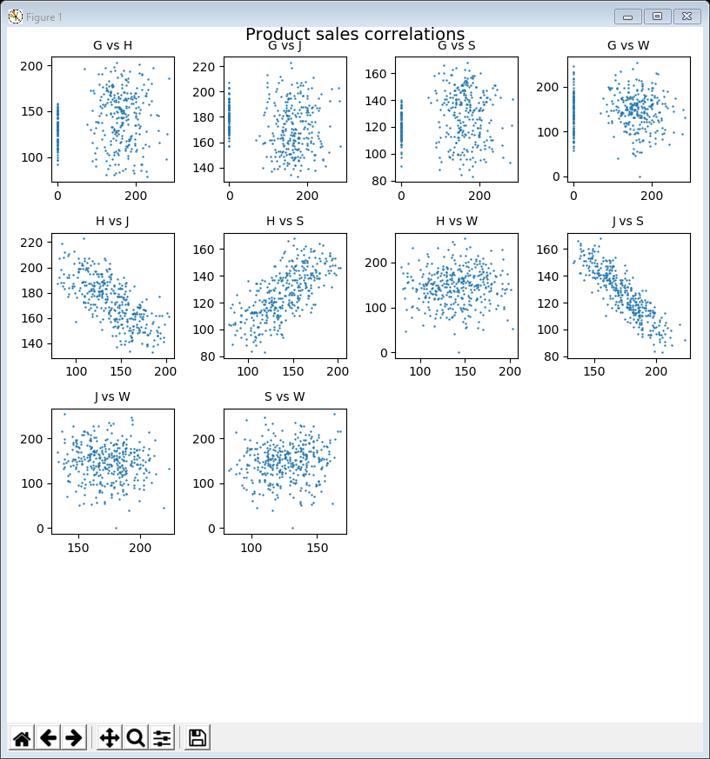
02ScatterPlot medium volume subplots.py
The following code creates the 10 subplots on the right
The single line in bold actually creates the scatter plot
the parameter s=0.5 changes the size of the dots
selected = ['G', 'H', 'J', 'S', 'W']
counter = 1
fig = plt.figure(figsize=(8, 8))
fig.suptitle('Product sales correlations',
fontsize=14, position=(0.5, 1.0))
for i, name_i in enumerate(selected):
for j in range(i + 1, len(selected)):
name_j = selected[j]
sub = fig.add_subplot(4, 4, counter)
sub.set_title(name_i + ' vs ' + name_j,
fontsize=10)
sub.scatter(data[name_i], data[name_j], s=0.5)
counter += 1
plt.subplots_adjust(wspace=0.5, hspace=0.5)
plt.tight_layout()
plt.show()
H has a negative correlation with J
H has a positive correlation with S
J has a strong negative correlation with S

Slide 11
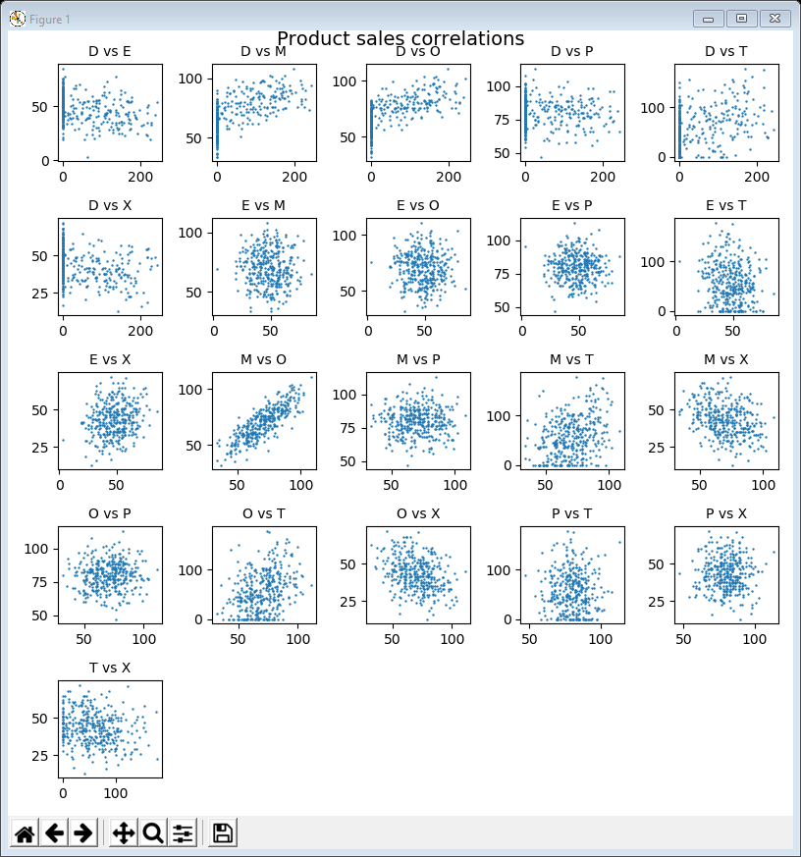
03ScatterPlot low volume subplots.py
The following code creates the 21 subplots on the right
Notice that the parameters of add_subplot() have changed from 4, 4 previously to 5, 5
because 21 subplots will not fit in 4 x 4 = 16 slots
selected = ['D', 'E', 'M', 'O', 'P', 'T', 'X']
counter = 1
fig = plt.figure(figsize=(8, 8))
fig.suptitle('Product sales correlations',
fontsize=14, position=(0.5, 1.0))
for i, name_i in enumerate(selected):
for j in range(i + 1, len(selected)):
name_j = selected[j]
sub = fig.add_subplot(5, 5, counter)
sub.set_title(name_i + ' vs ' + name_j,
fontsize=10)
sub.scatter(data[name_i], data[name_j], s=0.5)
counter += 1
plt.subplots_adjust(wspace=0.5, hspace=0.5)
plt.tight_layout()
plt.show()
M has a strong correlation with O

Slide 12
Interpretation
Remembering that correlation does not imply causation … what does it mean if one product is correlated with another?
It may mean that when someone buys product M they also buy product O at the same time
for example, table and chairs (assuming they’re sold separately)
It may mean there’s some underlying cause so that both products tend to be bought at the same time of year
for example, ice cream and sunblock
And the same is true for negative correlation which can be seasonal
for example, ice cream and gloves
Or negative correlation might mean that tastes are changing
for example, people switching from latte to flat white coffees
Our role as data scientists is to highlight correlation, not establish causation
However, it might then make sense to group strongly correlated variables together
for example, table and chairs

Slide 13
Correlation coefficient
You might realise that finding correlations by looking at scatter plots is tedious and error prone
to check the correlations for all 25 products against each other we would need to look at 300 subplots
if there’s 250 products then its 31,250 subplots!
You might also guess that there’s a way of measuring correlation numerically
in fact there are several and Pandas will calculate at least 3 different versions for you with .corr()
The default version in Pandas is the Pearson correlation coefficient
expressed as a number between -1 (perfect negative correlation) and +1 (perfect positive correlation)

Slide 14
Heat maps
Even with Pandas calculating correlations we still need to visualise them somehow
for 25 products, Pandas calculates 25 x 24 = 600 correlation coefficients
The standard way to do this is with a heat map
a coloured chart where blue represents cold (-1) and red represents hot (+1)
It’s certainly possible to do this in MatPlotLib
but it’s much easier using Seaborn, a high level visualisation library built on top of Pandas and MatPlotLib

Slide 15
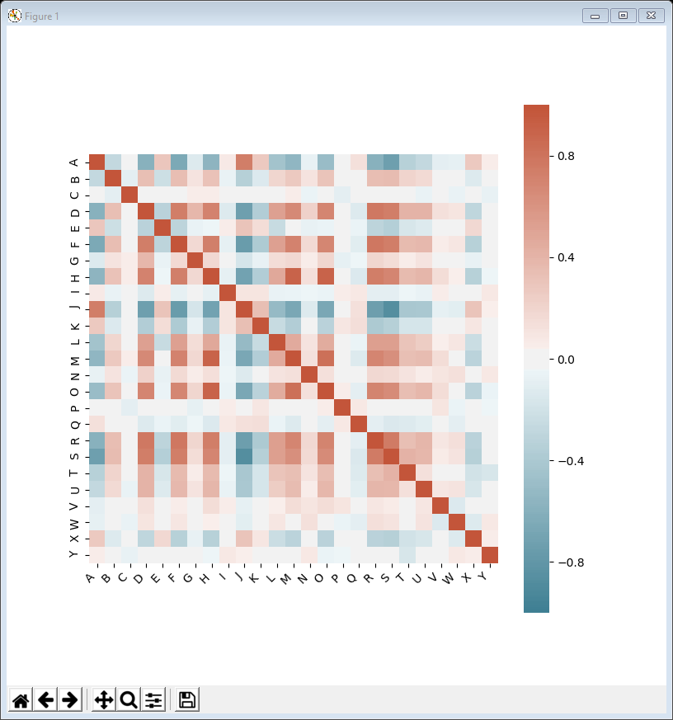
04HeatMap correlation all.py
Seaborn needs an extra import
Then this code creates the heat map
All the diagonal squares are red as each time-series is perfectly correlated with itself
Apart from that you are looking for strong red colours (positive correlation) or strong blue (negative correlation)
import seaborn as sns
plt.figure(figsize=(8, 8))
corr = data.corr()
ax = sns.heatmap(corr, vmin=-1, vmax=1, center=0,
cmap=sns.diverging_palette(220, 20, n=200),
square=True)
ax.set_xticklabels(ax.get_xticklabels(), rotation=45,
horizontalalignment='right')
plt.show()

Slide 16
05HeatMap correlation selected.py
There is still rather a lot of information and the company is not particularly interested in very low volume products
This code creates a heat map excluding very low volume
anything under 10,000 sales per year
The code also annotates the coefficients
annot_kws={"size": 8} sets the font size to 8pt
The strongest positive correlations are between H, M & O
The strongest negative are between J & S
A is also correlated with J and negatively correlated with S
selected = data.columns[data.sum() > 10000]
plt.figure(figsize=(10, 10))
corr = data[selected].corr()
ax = sns.heatmap(corr, vmin=-1, vmax=1, center=0,
cmap=sns.diverging_palette(220, 20, n=200),
square=True, annot=True, annot_kws={"size": 8})
ax.set_xticklabels(ax.get_xticklabels(), rotation=45,
horizontalalignment='right')
plt.show()

Slide 17
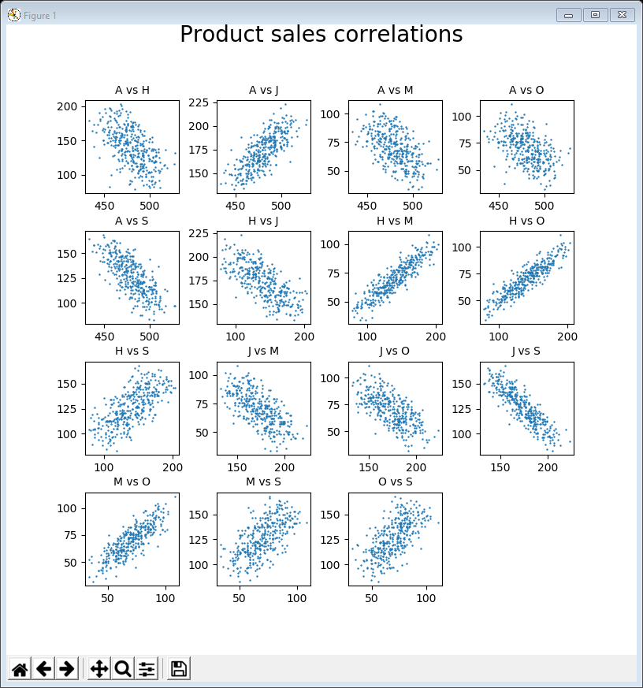
Example 06 – correlation subplots
We can now explore these in more detail using the code from example 02 or 03 and selecting correlated groups
selected = ['A', 'H', 'J', 'M', 'O', 'S']
counter = 1
fig = plt.figure(figsize=(8, 8))
fig.suptitle('Product sales correlations',
fontsize=14, position=(0.5, 1.0))
for i, name_i in enumerate(selected):
for j in range(i + 1, len(selected)):
name_j = selected[j]
sub = fig.add_subplot(4, 4, counter)
sub.set_title(name_i + ' vs ' + name_j,
fontsize=10)
sub.scatter(data[name_i], data[name_j], s=5)
counter += 1
plt.subplots_adjust(wspace=0.5, hspace=0.5)
plt.tight_layout()
plt.show()

Slide 18
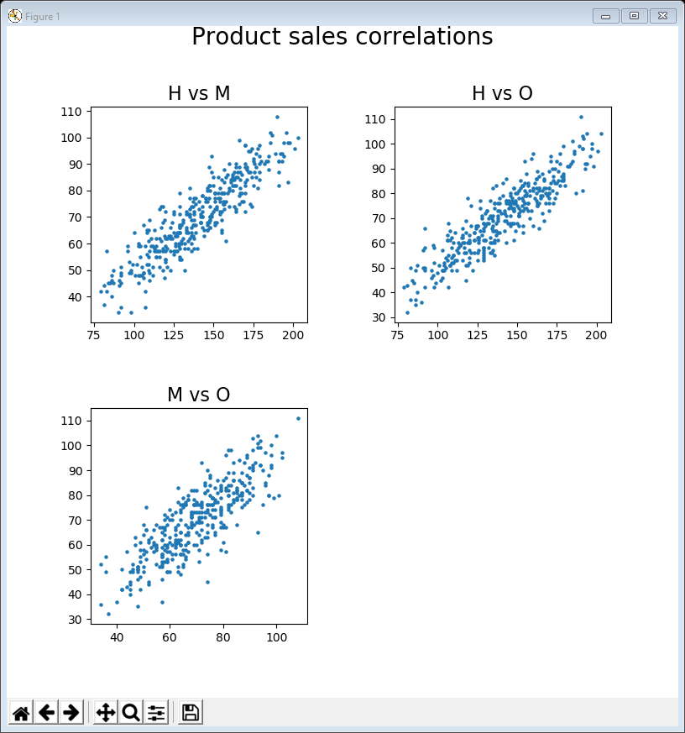
Example 07 – positive correlation subplots
We can even focus on just the strong positive correlations
selected = ['H', 'M', 'O']
counter = 1
fig = plt.figure(figsize=(8, 8))
fig.suptitle('Product sales correlations',
fontsize=14, position=(0.5, 1.0))
for i, name_i in enumerate(selected):
for j in range(i + 1, len(selected)):
name_j = selected[j]
sub = fig.add_subplot(2, 2, counter)
sub.set_title(name_i + ' vs ' + name_j,
fontsize=16)
sub.scatter(data[name_i], data[name_j], s=5)
counter += 1
plt.subplots_adjust(wspace=0.5, hspace=0.5)
plt.tight_layout()
plt.show()

Slide 19
Example 08 - negative correlation subplots
Or just strong negative correlations
selected = ['A', 'J', 'S']
counter = 1
fig = plt.figure(figsize=(8, 8))
fig.suptitle('Product sales correlations',
fontsize=14, position=(0.5, 1.0))
for i, name_i in enumerate(selected):
for j in range(i + 1, len(selected)):
name_j = selected[j]
sub = fig.add_subplot(2, 2, counter)
sub.set_title(name_i + ' vs ' + name_j,
fontsize=16)
sub.scatter(data[name_i], data[name_j], s=5)
counter += 1
plt.subplots_adjust(wspace=0.5, hspace=0.5)
plt.tight_layout()
plt.show()

Slide 20
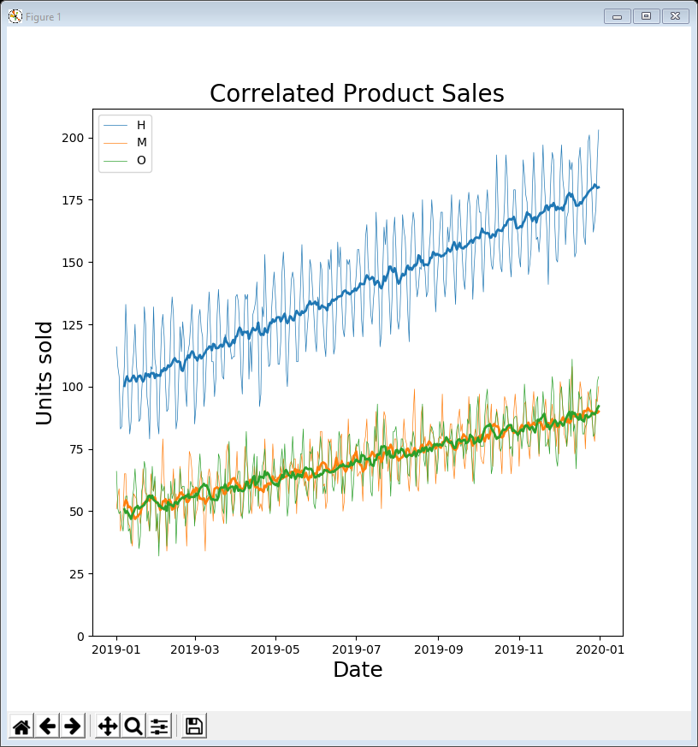
Example 09
Having identified correlated groups of time-series we can compare their line plots
e.g. with a rolling average from example 05, last week
H is climbing at twice the rate but the distance between them is increasing steadily
M & O are very closely aligned
possible explanation: every time someone buys 2 Hs, they also buy an O and an M

Slide 21
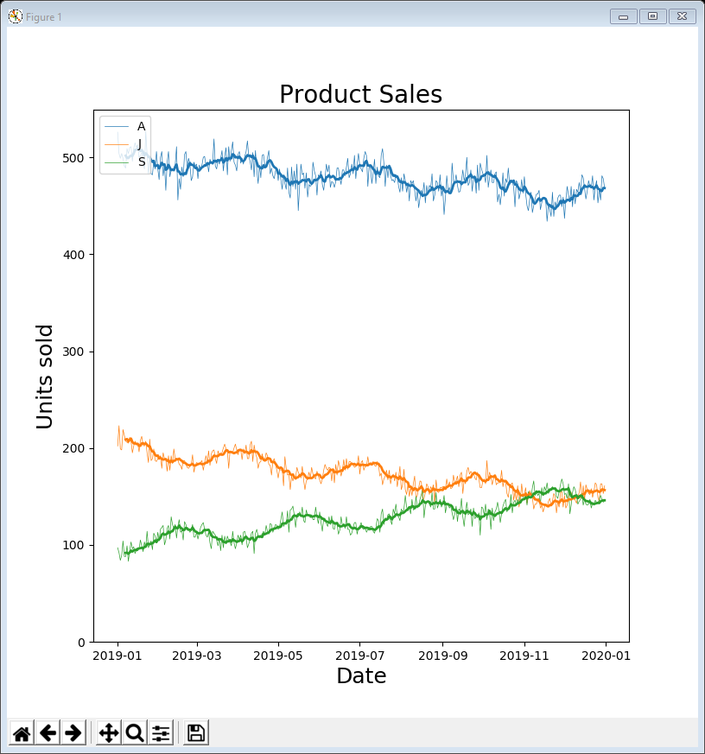
Example 10
Having identified correlated groups of time-series we can compare their line plots
e.g. with a rolling average from example 05, last week
A & J are declining slowly while S is climbing slowly
however they all exhibit related peaks and troughs
possible explanations: sales are seasonal / every time someone buys a J they also buy several As /
people are gradually switching to S instead of J

Slide 22
Product comparisons
So far we have looked at comparisons between time-series where the common index values are the dates
However, correlations can be made between other things
for example, the common index values could be the products themselves
then we can check correlations between price, profit, total sales, marketing, …
To do this we need some more data
marketing_data = pd.read_csv('https://tinyurl.com/ChrisCoDV/Products/MarketingPerProduct.csv’,
index_col=0)
price_per_unit = pd.read_csv('https://tinyurl.com/ChrisCoDV/Products/PricePerUnit.csv',
index_col=0)
profit_per_unit = pd.read_csv('https://tinyurl.com/ChrisCoDV/Products/ProfitPerUnit.csv',
index_col=0)

Slide 23
Summary data
We can then construct a dataframe containing summary data
summary_data contains 25 rows (one per product) and 5 columns:
Price: the retail price per unit (the price the customer pays, from £8 to £49)
Profit: the amount of profit per unit (from £1 to £25)
Sales: the total sales over the year calculated from the daily sales data
Marketing: the total marketing budget for this product (£0 to £44,000)
Cost: the cost per unit calculated from the price and profit (the cost of manufacturing or buying in the product, from £6 to £45)
summary_data = pd.DataFrame(index=data.columns)
summary_data['Price'] = price_per_unit.values
summary_data['Profit'] = profit_per_unit.values
summary_data['Sales'] = data.sum().values
summary_data['Marketing'] = marketing_data.values
summary_data['Cost'] =
summary_data['Price'] - summary_data['Profit']
print(summary_data.head())
print(summary_data.describe())

Slide 24
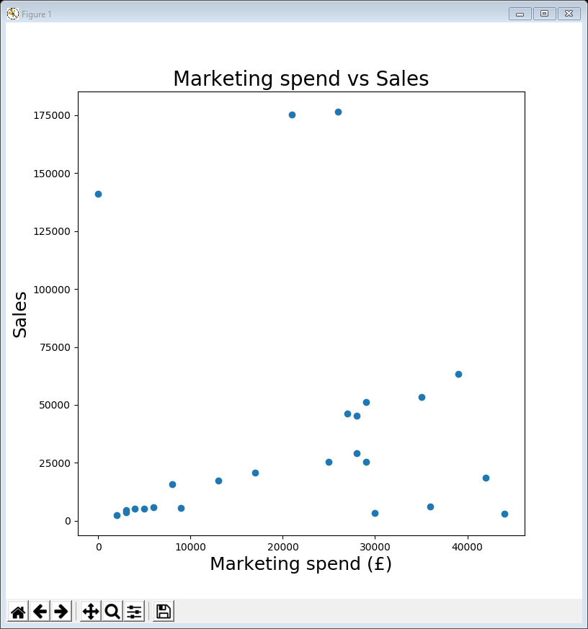
11ScatterPlot marketing vs sales.py
Can now apply the techniques as before
For example we can check if the marketing budget is based on total sales
But no real evidence of that based on the scatter plot
plt.figure(figsize=(8, 8))
plt.scatter(summary_data['Marketing’], summary_data['Sales'])
plt.title('Marketing spend vs Sales', fontsize=20)
plt.xlabel('Marketing spend (£)', fontsize=18)
plt.ylabel('Sales', fontsize=18)
plt.show()

Slide 25
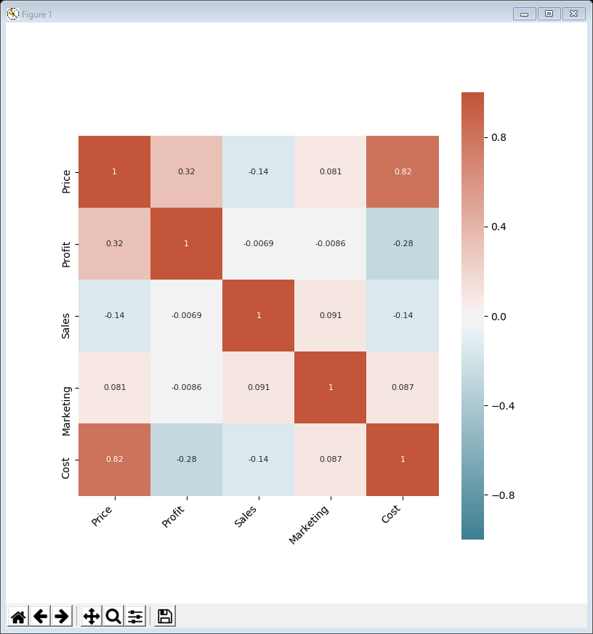
12HeatMap summary correlation.py
The next example calculates a heat map for correlations between the 5 variables
There is only one really strong correlation – between price and cost
as you might expect – the more something costs to manufacture / buy in, the more the company will charge for it
plt.figure(figsize=(8, 8))
corr = summary_data.corr()
ax = sns.heatmap(corr, vmin=-1, vmax=1, center=0,
cmap=sns.diverging_palette(220, 20, n=200),
square=True, annot=True, annot_kws={"size": 8})
ax.set_xticklabels(ax.get_xticklabels(), rotation=45,
horizontalalignment='right')
plt.show()

Slide 26
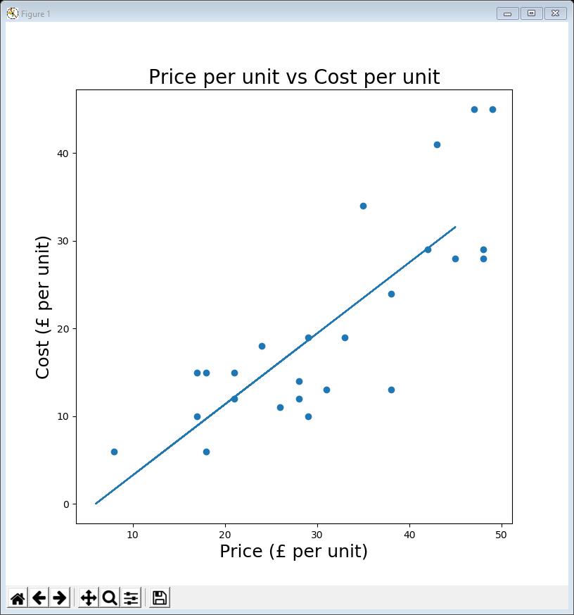
13ScatterPlot price vs cost + linear regression.py
Now we can visualise the scatter plot of price vs cost
Can even include a linear regression to show “average” price vs cost
strictly speaking not a trend line although it uses the same code
plt.figure(figsize=(8, 8))
plt.scatter(summary_data['Price'], summary_data['Cost'])
z = np.polyfit(summary_data['Price'], summary_data['Cost'], 1)
trend = np.poly1d(z)
plt.plot(summary_data['Cost'], trend(summary_data['Cost']))
plt.title('Price per unit vs Cost per unit', fontsize=20)
plt.xlabel('Price (£ per unit)', fontsize=18)
plt.ylabel('Cost (£ per unit)', fontsize=18)
plt.show()

Slide 27
Segmentation
Finally it can sometimes be valuable to segment the data
The following code creates 3 subsets (high, medium & low) where the rows are selected based on total sales in the daily sales data
The rationale is that some subsets of data may exhibit particular correlations
summary_data_high = summary_data.loc[data.sum() > 100000]
summary_data_medium = summary_data.loc[(data.sum() > 40000)
& (data.sum() <= 100000)]
summary_data_low = summary_data.loc[data.sum() <= 40000]

Slide 28
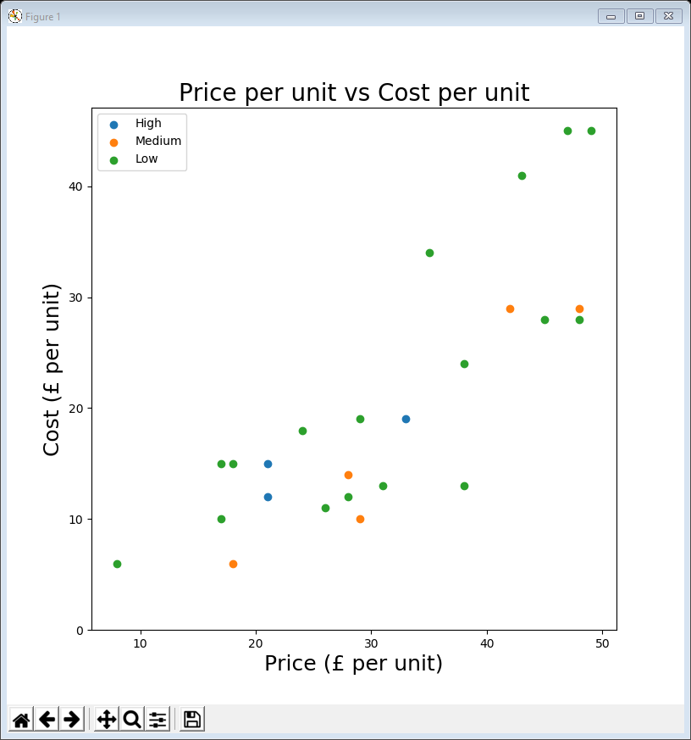
14ScatterPlot price vs cost coloured.py
Now we can visualise the scatter plot with colours representing different subsets
In fact, in this case the segmentation doesn’t really reveal anything of interest (but the tutorial exploration might …)
plt.figure(figsize=(8, 8))
plt.scatter(summary_data_high['Price'], summary_data_high['Cost'])
plt.scatter(summary_data_medium['Price'], summary_data_medium['Cost'])
plt.scatter(summary_data_low['Price'], summary_data_low['Cost'])
plt.ylim(ymin=0)
plt.title('Price per unit vs Cost per unit', fontsize=20)
plt.xlabel('Price (£ per unit)', fontsize=18)
plt.ylabel('Cost (£ per unit)', fontsize=18)
plt.legend(['High', 'Medium', 'Low'], loc=2)
plt.show()

Slide 29
Data conclusions
Reminder - we are not making business recommendations
let the business analyst decide what to do
However …
can identify some strongly correlated products
it might make sense to group these together (for example, if product H was withdrawn, would people stop buying M & O too)
also looked at correlations in the product summary data

Slide 30
Lecture summary
Looked at visualising correlations
scatter plots
heat maps
Can easily detect & visualise correlations and then, for example, explore them in the original time-series data

